Slide 1
Hierarchical Text-Conditional Image Generation with CLIP Latents
Ramesh A, Dhariwal P, Nichol A, Chu C, Chen M., “Hierarchical Text-Conditional Image Generation with CLIP Latents”, 2022, Available: https://arxiv.org/abs/2112.10741
2025-03-04
Sein Choi
Intelligent Vision Processing Lab. (IVPL)
https://ivpl.sookmyung.ac.kr
Div. of AI Engineering, Sookmyung Women’s University
E-mail: csi1806@sookmyung.ac.kr

Slide 2
No. | Title | Keyword | Cite
1 | Learning Transferable Visual Models From Natural Language Supervision | Contrastive Learning, Multimodal Representation | Alec Radford, Jong Wook Kim. (2021). Learning Transferable Visual Models From Natural Language Supervision, In Proc. of the 38th International Conference on Machine Learning, pages 8748–8763. PMLR. [Online]. Available: https://arxiv.org/abs/2103.00020
2 | GLIDE: Towards photorealistic image generation and editing with text-guided diffusion models | Text-to-Image Generation, Diffusion Models, guided image synthesis | A Nichol, P. Dhariwal, A. Ramesh. “GLIDE: Towards photorealistic image generation and editing with text-guided diffusion models”, In Proc. of the 39th International Conference on Machine Learning, 2022, pp. 16907-16921. Available: https://arxiv.org/abs/2112.10741
3 | Hierarchical Text-Conditional Image Generation with CLIP Latents | Text-to-Image Generation, CLIP Latents, unCLIP, Diffusion Models | Ramesh A, Dhariwal P, Nichol A, Chu C, Chen M., “Hierarchical Text-Conditional Image Generation with CLIP Latents”, 2022, Available: https://arxiv.org/abs/2112.10741
4
5

Slide 3
Contents
Introduction
Method
Prior 𝑷(𝒛_𝒊 |𝒚)
Decoder 𝑷(𝒙┤| 𝒛_𝒊,𝒚)
Image Manipulations by using unCLIP
Probing the CLIP Latent Space
Evaluations
Limitations
Conclusion

Slide 4
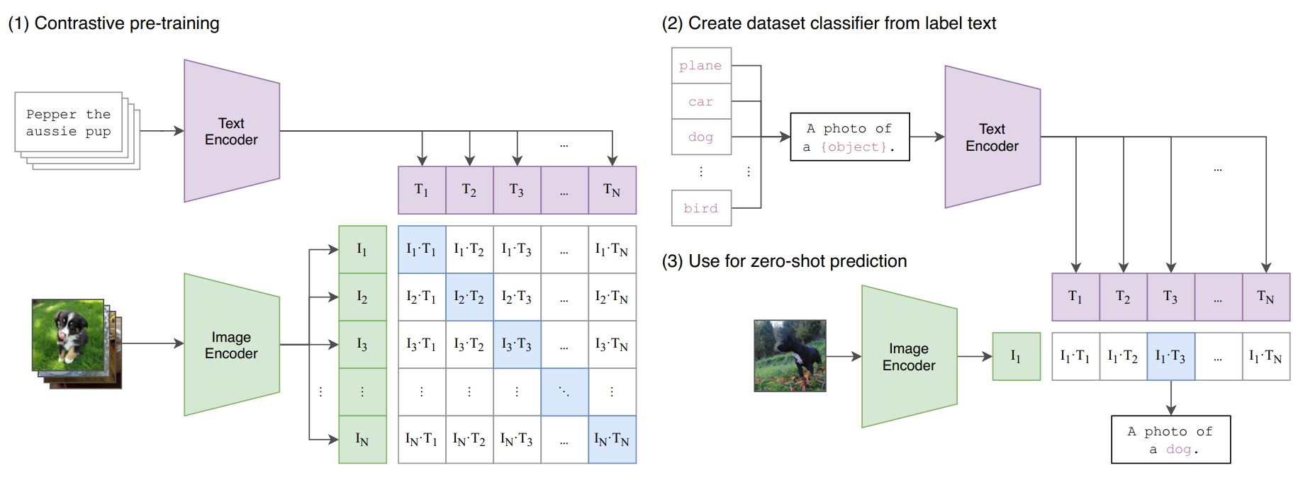
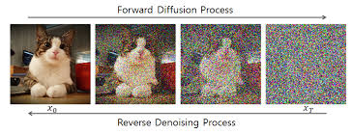
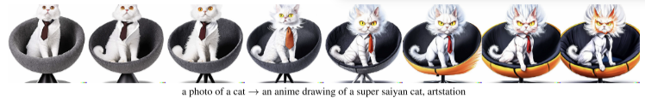
Introduction
Advantage of CLIP & Diffusion model
CLIP: Robustness to image distribution shifts, Zero-shot capability
Diffusion : Framework for generating images and videos
CLIP
Encoder
Diffusion
Decoder
Possibilities of Text-to-Image Generation
Allowing for semantic modifications, which GANs cannot achieve, while CLIP helps observe recognized or ignored features in images.
DALL-E 2

Slide 5
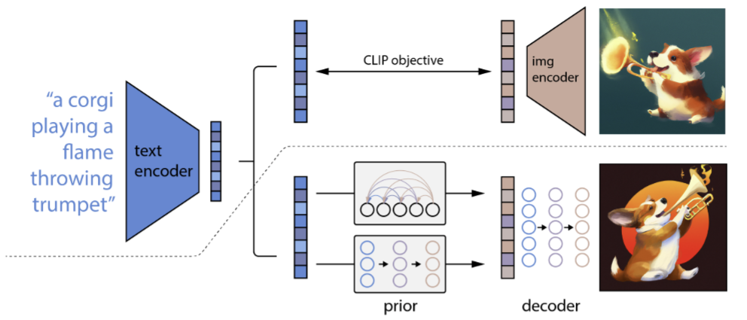
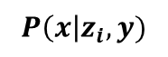
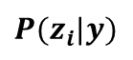
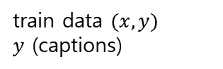
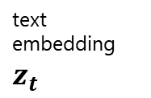
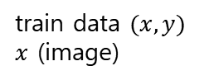
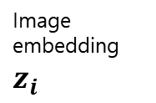
Method
A high-level overview of unCLIP
unCLIP : full text-conditional image generation stack
⇒ DALL-E 2
1. Pretraining CLIP
train data $(x,y)$
$x$ (image)
train data $(x,y)$
$y$ (captions)
text
embedding
$$z_{t}$$
Image embedding $z_{i}$
AR Prior
Diffusion Prior
2. Text-to-Image Generating Model
3. Super Resolution
(Upsampling)
$P(z_{i}|y)$
$$P\left(x\right|z_{i},y)$$
(64→256, 256→1024)

Slide 6
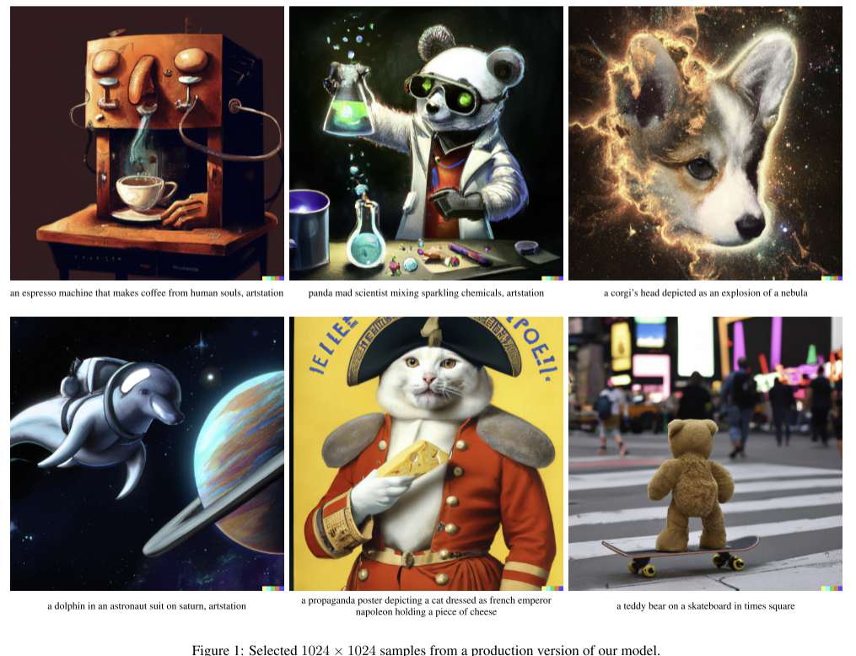
Generated Image

Slide 7

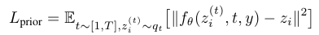
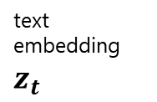
Prior $P(z_{i}|y)$
AR(Autoregressive) Prior
Convert CLIP embeddings into discrete sequences and predict them autoregressively in steps.
Using PCA, 1024 -> 319dims
319 dimensions -> 1024 discrete buckets (quantized values)
Use a Transformer model with a causal attention mask to predict the resulting sequence
Diffusion Prior
Handle z_i as continuous vectors and gradually remove noise to predict image embeddings.
text
embedding
$$z_{t}$$
(condition)
caption y
Generate two z_i samples and select the one with the highest similarity to z_t

Slide 8
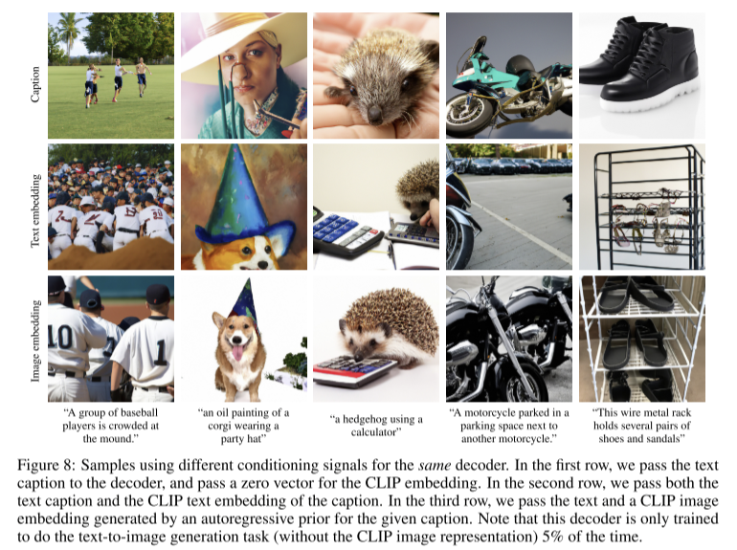
Importance of Prior

Slide 9
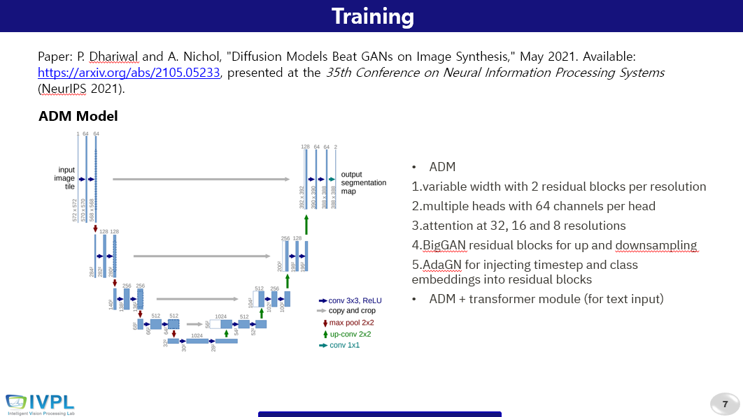
Decoder $P\left(x\right|z_{i},y)$
Decoder
Architecture : Improved DDPM
Guidance : Classifier-free guidance
Upsampling
2 upsampler models (64→256, 256→1024)
corrupt
gaussian blur → BSR degradation
numerical stability, ¼ random crop
No guidance,
Using unconditional ADMNet
(cf. GLIDE paper review)
64x64
256x256
1024x1024

Slide 10
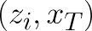
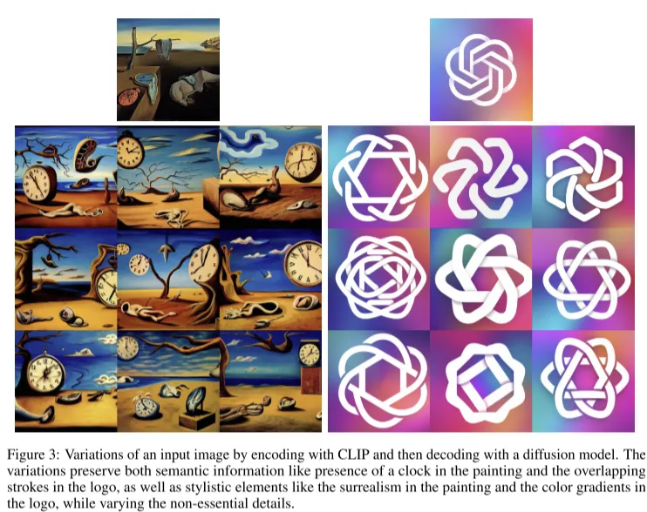
Image Manipulations by using unCLIP
bipartite latent representation
Variations

Slide 11
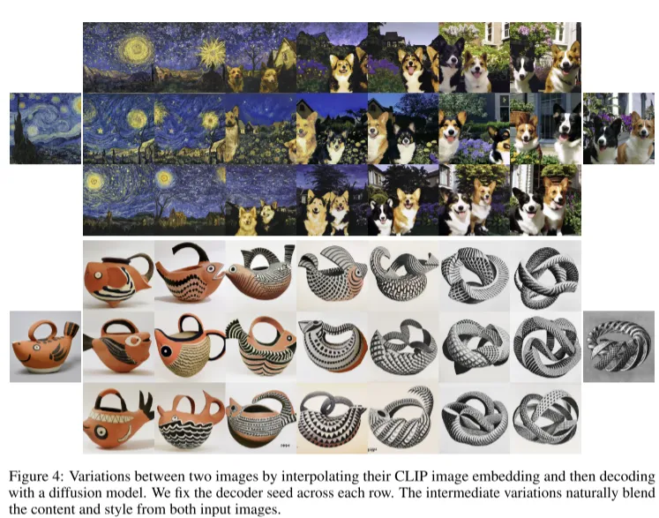
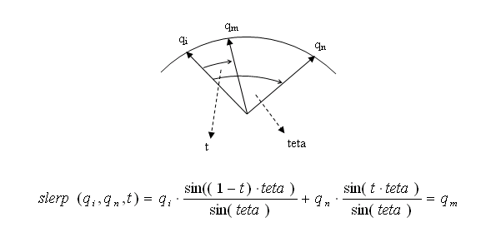
Image Manipulations
Interpolations
Interpolation method for generating a new image by blending the characteristics of two images

Slide 12
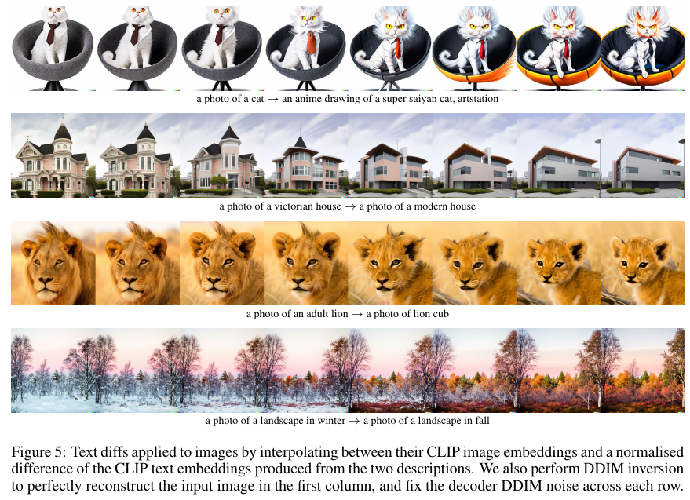
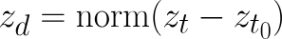
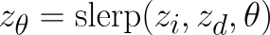
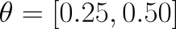
Image Manipulations
Text Diffs
The method that transforms Image Embedding in proportion to the differences in Text Embedding
clip text embedding vector
a photo of cat :
an anime ,,, :
2. Calculate text diff vector
3.
4. decoding

Slide 13
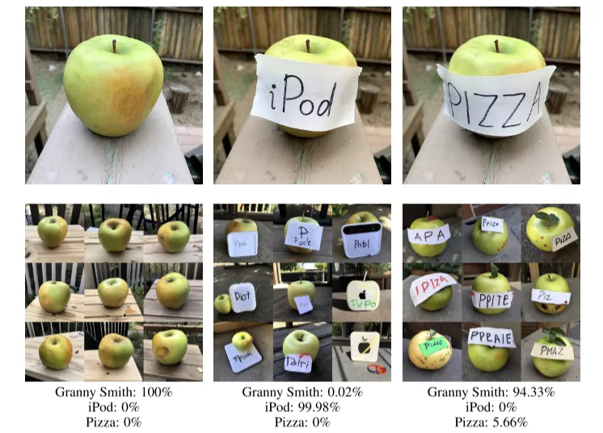
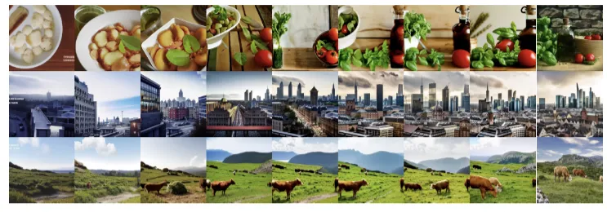
Probing the CLIP Latent Space
typographic attack
Text overlays on objects lead CLIP to predict objects described by the text (iPod, pizza) instead of those in the image (apple)
PCA Reconstructions
Reconstruct CLIP image embeddings into more PCA dimensions:
Initial dimensions: Capture approximate semantic information.
Subsequent dimensions: Encode detailed information, such as the exact shape of objects.

Slide 14
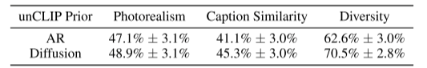
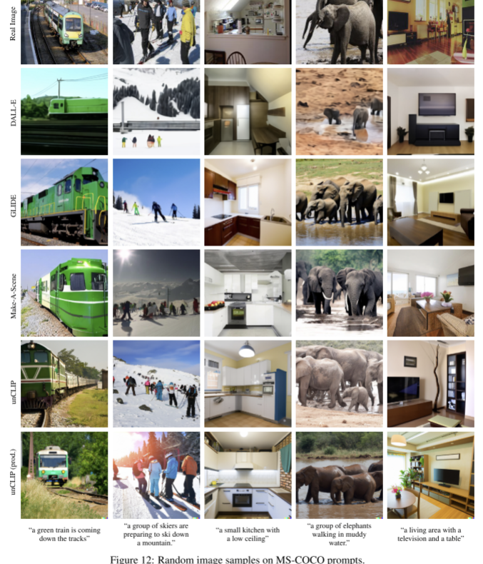
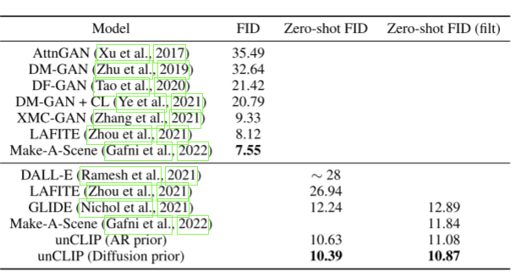
Evaluations
Human evaluations comparing unCLIP(AR/Diffusion) to GLIDE
Comparison on MS-COCO

Slide 15
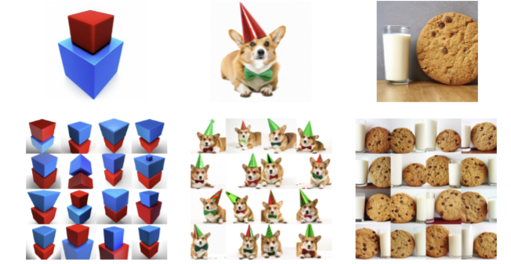
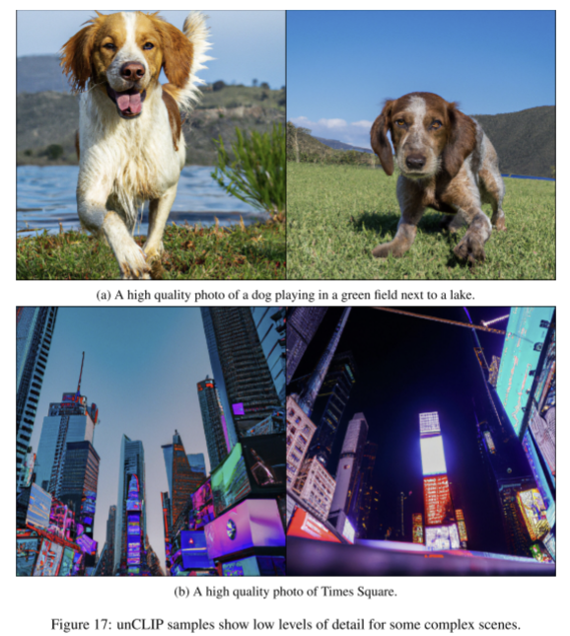
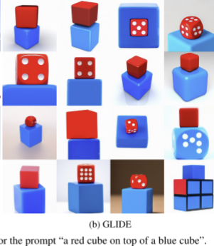
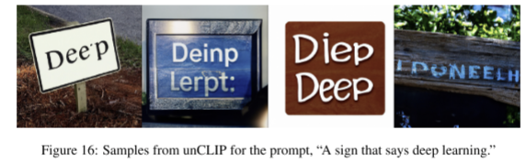
Limitations / Conclusion
Conclusion
Text encoder (CLIP) – prior – decoder (Diffusion) structure for text-to-image generation model.
Personal thought: I believe that CLIP's robustness and its ability to effectively utilize the semantic relationships between text and images result in a model with high diversity.

Slide 16
Thank you for your attention.!!!
QnA

